Slide 1
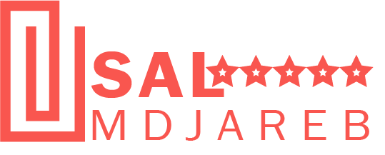


Grow with Sal M’djareb reviews.
Manage Reviews Seamlessly Anytime. Anyday.

Slide 2

Agenda
SECTIONS
Executive Summary SAL MDJAREB Technology SAL MDJAREB Algeria: Investment Case and Business Plan SAL MDJAREB Operating Model Appendix

Slide 3
Executive Summary
Challenge addressed
Build an independent reference that foster trust and inspire collaboration between consumers and brands.
Build a community of trusted reviews that generates genuine feedback for brand.
Improve consumer shopping experience
Innovative solution proposed
SAL MDJAREB is an online platform for hosting consumers reviews and recommendation that generates genuine feedback for brands’ growth.
Medium & Long-term impact
Genuine reviews enhance brands credibility and drive improvements and growth.
Job creation …………………
Advanced digitalisation of activities through innovation for the ultimate benefit of end-users/consumers,
Skills improvements through on-the-job training.
Value proposition
For Brands : improved reputations and revenue, increased traffic, exposer and visibility.
For Consumers: easy to decide, Browse Local brands, saved time and money.
For Market: competitive offering ,
EBITDA positive projected in 2026,

Slide 4
Agenda
SECTIONS
Executive Summary SAL MDJAREB Technology SAL MDJAREB Algeria: Investment Case and Business Plan SAL MDJAREB Operating Model Appendix

Slide 5






Sal Mdjareb
improve shopper experience, drive brand and service performance.
Shopper and consumer reviews platform
Online Reviews
Market Research
Channel Understanding
Compliance
Tracking
Brand Recommendation
Brand, Consumer, Shopper, Channel understanding

Slide 6
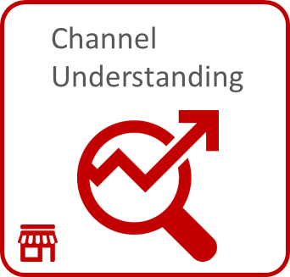
SARL MDJAREB………..

Slide 7
Data is captured via ……….

Slide 8
Purpose built information capture system

Slide 9

Sophisticated quality controls capture and 100% validation…
MMMM
HHH
OOOOO
GGGG
JJJJJ
HHHH
LLLLL

Slide 10
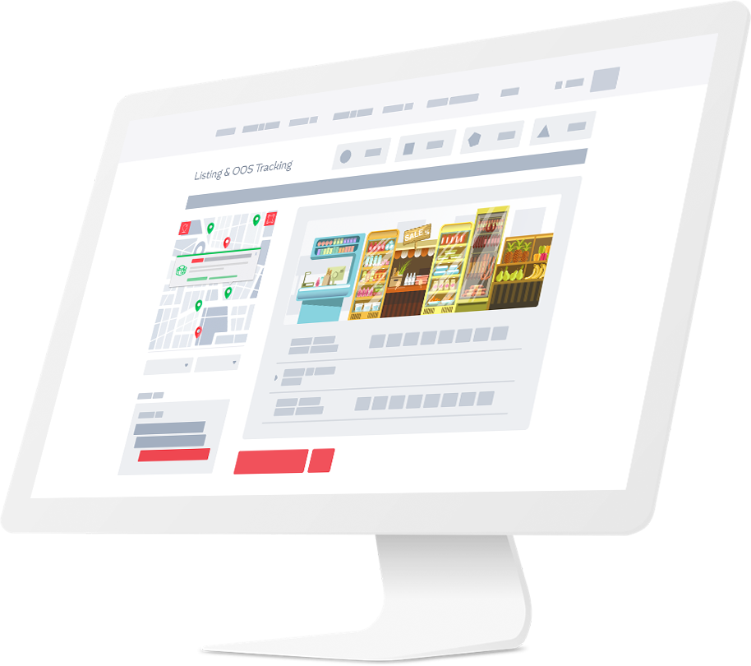

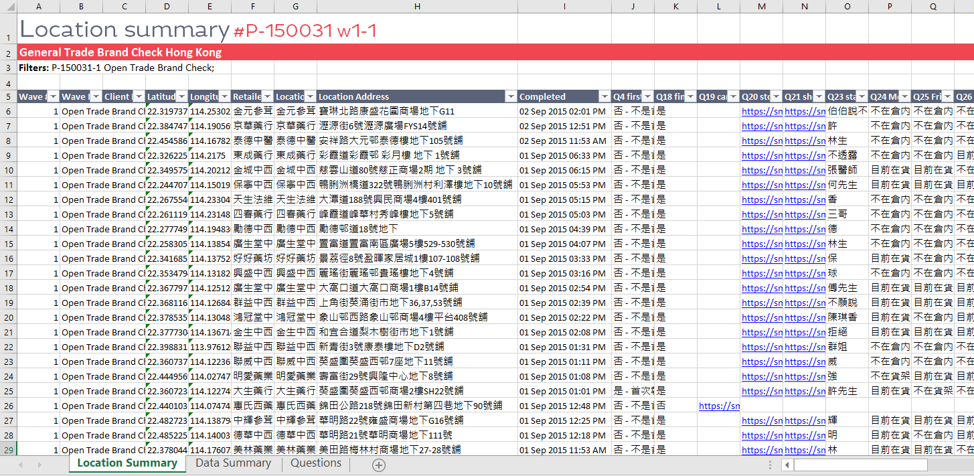
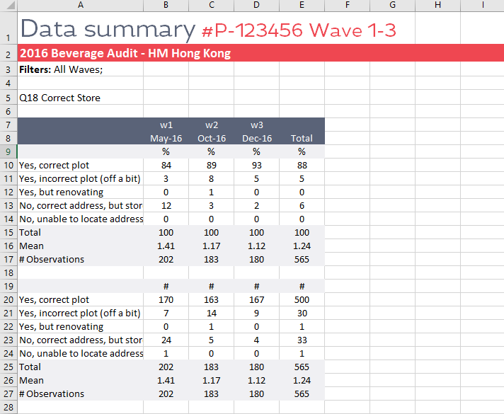
Key deliverables
1. Real-time interactive client portal
2. Location & aggregate data
3.Customized research reports

Slide 11



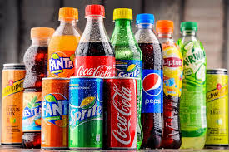

Sector experience
Household
Beverages
Chocolate, Snacks & Confectionary
Personal Care & Beauty
IMF & Early Life Nutrition

Slide 12
Agenda
SECTIONS
Executive Summary SAL MDJAREB Technology SAL MDJAREB Algeria: Investment Case and Business Plan SAL MDJAREB Operating Model Appendix

Slide 13
Founding Partners’ Profiles
PROFILE
EXPERIENCE
XXXXXXXXXXXS
YYYYYYYYYYYYY
Partner and co-founder at Global Marble …..
- Market Research: (Quant, Qual, Panels), Data Analysis,
- Brands Performance, Consumer insights.
BAHANI BILLEL
CEO Sal mdjareb
UNIVERSITE DE BLIDA; INSIM
10 Years in Market research and project management
Founding partner at xyz
Research Executive ………………….
Managing Director ……….
Partner and co-Founder at ………….
- Strategic Management
- Markey Research
- Consumer insights
AZOUZ MOHAMED
COO SAL MDJAREB
Insim Algiers, Algeria
5 years in Market research
Founding partner at….

Slide 14
Target Market
Launch
Over 2,000 reviews habeen submitted since launch
Partnership
Growing relationships with local FMCG champions with regional aspirations
Q3/2022 Sal Mdjareb launched in Algeria

Slide 15
Economic Model
Sal Mdjareb offers to clients a diverse portfolio of Consumer information including:
Information on rating Brands, services and other sectors
Market research studies
Brand performance and optimization
Information captures from any locations are targeting several industries:
FMCG sector (Fast Moving Consumer Goods)
Automotive industry
Pharmaceutical and para-pharmaceutical
+
Revenue Stream | Description | Invoicing model | Clients acquisition strategy | Gross Margin
Retail Audit Panel | Fixed sample of POS to track multi-category of products targeting several clients with basic data: Location, On-Shelf Availability; Out of Stock and Facing | Subscription-based service | Attractive service Syndicated (Multi-clients) Showcase the full power of the SmartRocket technology Low margin | 14%
Retail Audit Tracker | Sample of POS used to track specific data per waves | Commercial contract with several waves | Leverage on the panel to offer tracking of specific and strategic data over the time with medium range margins | 23%
Retail Audit Ad-hoc | Sample of POS used to gather data in one off approach | Commercial contract | Leverage on the panel to add services à la carte with high margins | 55%
Mystery shopping Tracker | Evaluation process to measure the quality experience and collect specific information on products and services per waves | Commercial contract with several waves | Differentiating factor of the SmartRocket Portal capturing and reporting observations in real time without any loss, High margins | 56%
Mystery shopping Ad-hoc | Evaluation process to measure the quality experience and collect specific information on products and services in one - off | Commercial contract | Idem above | 55%
Market Research Studies | Any set of techniques used to gather information and better understand a company’s target market (survey, Focus group, client’s satisfaction, Interviews, planogram compliance, etc,) | Commercial contract | Differentiating factor of the SmartRocket Portal enabling data export within minutes | 30%
Online Retail Audit | Extracting brand’s data from commercial web sites and online stores | Subscription-based service or commercial contract | First mover advantage in the target market | 46%

Slide 16
Economic Model
Sal Mdjareb offers to clients a diverse portfolio of Consumer information including:
Information on rating Brands, services and other sectors
Market research studies
Brand performance and optimization
Information captures from any locations are targeting several industries:
FMCG sector (Fast Moving Consumer Goods)
Automotive industry
Pharmaceutical and para-pharmaceutical
+
Revenue Stream | Description | Invoicing model | Clients acquisition strategy | Gross Margin
Retail Audit Panel | Fixed sample of POS to track multi-category of products targeting several clients with basic data: Location, On-Shelf Availability; Out of Stock and Facing | Subscription-based service | Attractive service Syndicated (Multi-clients) Showcase the full power of the SmartRocket technology Low margin | 14%
Retail Audit Tracker | Sample of POS used to track specific data per waves | Commercial contract with several waves | Leverage on the panel to offer tracking of specific and strategic data over the time with medium range margins | 23%
Retail Audit Ad-hoc | Sample of POS used to gather data in one off approach | Commercial contract | Leverage on the panel to add services à la carte with high margins | 55%
Mystery shopping Tracker | Evaluation process to measure the quality experience and collect specific information on products and services per waves | Commercial contract with several waves | Differentiating factor of the SmartRocket Portal capturing and reporting observations in real time without any loss, High margins | 56%
Mystery shopping Ad-hoc | Evaluation process to measure the quality experience and collect specific information on products and services in one - off | Commercial contract | Idem above | 55%
Market Research Studies | Any set of techniques used to gather information and better understand a company’s target market (survey, Focus group, client’s satisfaction, Interviews, planogram compliance, etc,) | Commercial contract | Differentiating factor of the SmartRocket Portal enabling data export within minutes | 30%
Online Retail Audit | Extracting brand’s data from commercial web sites and online stores | Subscription-based service or commercial contract | First mover advantage in the target market | 46%

Slide 17

Competition
Sal Mdjareb is the sole player offering Brands and services reviews through its disruptive digital application in the target market
Players | Reviews & online panel | Real time information | Market Research
Sal madjareb
SmartRocket
Retail Zoom
IMMAR
Ipsos
MMR
Nielsen

Slide 18
Return Analysis
The Sal Mdjareb deal is showing very attractive returns with conservative assumptions in terms of growth and exit valuation on top of strong impact in terms of post COVID 19
Equity investment Ticket Transform Fund: US$ 0,95m for an equity ownership of 30%
The founders have skin in the game and are fully aligned by investing US$ 50k as equity contribution (already spent) and mobilizing significant time and salary cuts to deliver the business plan
Exit Valuation: 2x revenues 2024
Financial Return Transform Fund
IRR : 28%
MoC: 2,4x
Capital Gain: US$ 1,3m
Significant measurable development impact achieved
US$
US$

Slide 19
Agenda
SECTIONS
Executive Summary SAL MDJAREB Technology SAL MDJAREB Algeria: Investment Case and Business Plan SAL MDJAREB Operating Model Appendix

Slide 20


Drivers of brand and business growth
Mental Availability
(Create a Compelling Expectation)
Physical Availability
(Match where & how consumers buy)
Salience
Consistent, memorable messaging
Cultivate distinctive brand assets
Build category relevance
PRESENCE - are you where you should be?
PROMINENCE – are you easy to find & buy?
RELEVANCE – are you relevant at the POS?
Performance
*Byron Sharp & Jenni Romaniuk: How Brands Grow

Slide 21


Service areas
PRESENCE - are you where you should be?
Build/ update/ clean target channel universes (all channels)
Investigate emerging/ unmeasured channels
Store attractiveness & categorisation measures
Brand & SKU listing
PROMINENCE – are you easy to find & buy?
Category SKU list building & planogram
Check quality of in store execution/ sales fundamentals
Check Parallel Imports
Category, brand & product in store performance & share
Category & brand POS materials usage & share
RELEVANCE – do you create & leverage relevance at POS?
Shopper experience (in store advocacy & purchase experience)
FOUNDATIONAL & STRATEGIC SUPPORT
Category purchase structure by channel, channel selection drivers & channel volumes
Compliance
Checking
Consumer Experience

Slide 22
Thank you
contact.dz@salmdjareb.com
www.salmdjareb.com

